Slide 1



SQL PROJECT : INSTAGRAM USER DATA ANALYSIS
- HARMANPREET KAUR

Slide 2

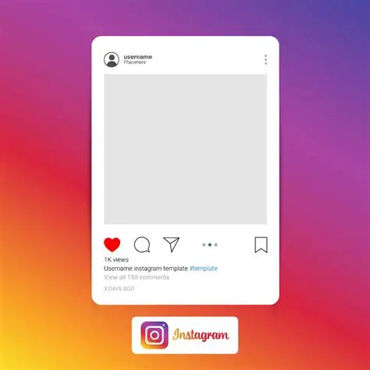
ABOUT INSTAGRAM
Instagram is a popular social networking platform used for sharing visual content such as images and videos.
It generates large volumes of user interaction data including likes, comments and shares.
This data is valuable for analyzing user behavior, engagement patterns and content performance.

Slide 3
INTRODUCTION
Social media platforms like Instagram generate large amounts of user data.
This project uses SQL to analyze user activity, engagement and content performance.
The goal is to derive insights that can help improve marketing strategies and enhance user experience.

Slide 4
PROBLEM STATEMENT
In this project, I’m working as a data analyst at Meta where the goal is to analyze Instagram user data.
The objective is to improve engagement, retention and user acquisition by identifying patterns in user behavior.
Based on the analysis I will provide insights and recommendations to support targeted marketing strategies.

Slide 5
DATA ATTRIBUTES The dataset contain information about 7 tables. Below is an overview of the dataset.
TABLES
COLUMNS
Users Table : Information about users registered on the platform.
Photo Table : Information about the photos uploaded by users.
Comments Table : Stores all comments made by users on photos.
Likes Tables : Tracks which users liked which photos.
Follows Table : Track users relationships (followers and followees).
Tags Table : Stores unique tags that are associated with photos.
Photo Tags Table : Tags on photos
comment_id : unique identifier for each comment
comment_text : text content of a given comment
user_id : unique identifier for each user
photo_id : unique identifier for each photo
created_at : date of interaction in the tables like, photos, tags
follower_id : user_id of the follower for a certain user
followee_id : user_id of followee for a certain user
tag_id : unique identifier for each tag
image_url : link to the image posted on the platform
username : username chosen by the user

Slide 6
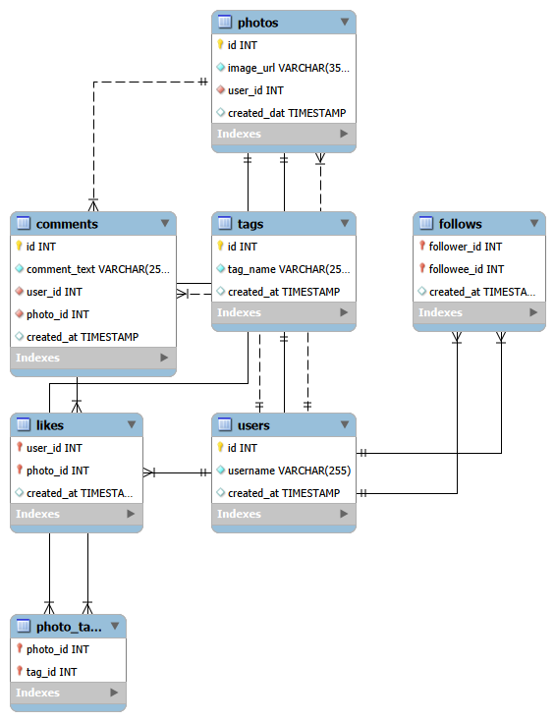
DATABASE SCHEMA

Slide 7
DATA QUALITY AND VALIDATION
The dataset was checked for data quality issues before analysis.
No duplicates records found in the dataset.
-- check duplicates
select id, count(*) from users
group by id
having count(*) > 1;
No missing (null) values detected.
-- check null values
select count(*) from users
where id is null;
Data consistency verified across all tables.
Relationships between tables are properly maintained.
METRIC | COUNT
Total Records | 100
Duplicates | 0
Null Values | 0
Valid Records | 100

Slide 8
DATASET SUMMARY
The dataset consists of data of Instagram users.
It includes 7 tables :
- Users
- Photos
- Comments
- Likes
- Photos
- Tags
- Photo Tags
In total, the dataset contains data of 100 Instagram users including their activity and engagement with the content.

Slide 9
METHODOLOGY
SQL Techniques
Data Processing
Analysis Approach
Group by for aggregation
Joins functions (inner join, left join and right joins)
CTE (Common Table Expressions)
Window Functions (Ranking)
Handling null values coalesce function.
Excluding duplicates using distinct function.
Aggregation of number of likes, comments and posts.
Identify Key metrics like rate of engagement.
Segmentation of users into different categories.
Generating insights and recommendations.

Slide 10
KEY METRICS AND VISUALISATION

Slide 11
USER ACTIVITY DISTRIBUTION
Highly engaged users dominate (~77%), indicating strong interaction levels on the platform.
Content creators are very limited (~3%), showing a heavy dependency on a small group for content generation.
Inactive + moderately active users (~20%) represent a clear opportunity for engagement improvement and growth.

Slide 12
TOP USERS BY ENGAGEMENT
Engagement is highly concentrated among top users with Eveline95 and Cesar93 leading significantly.
Higher posting activity directly correlates with higher engagement levels.
Mid-tier users show potential to become top performers with targeted strategies.

Slide 13
USER SEGMENTATION ANALYSIS
Content Creators show the highest engagement due to higher posting volume.
Highly Engaged Users contribute consistent interaction, forming the core active user base
Engagement is skewed toward a small group of users indicating reliance on power users

Slide 14
TOP INFLUENCER ANALYSIS
Engagement is highly concentrated among a few top influencers, with the top user (Eveline95) leading significantly.
There is a clear performance gap between top and mid-level influencers indicating unequal contribution.

Slide 15
USER ENGAGEMENT BY JOINING YEAR
2016 users dominate the platform with higher user count (65%).
Engagement is significantly higher :
- Comments : 5077 vs 2411
- Likes : 52 vs 25

Slide 16
USER SEGMENTATION BY NUMBER OF POSTS
Majority of users fall in low to moderate posting range (1-5 posts).
26 users have never posted indicating passive behavior.
Only 7 users are highly active (5+ posts).

Slide 17
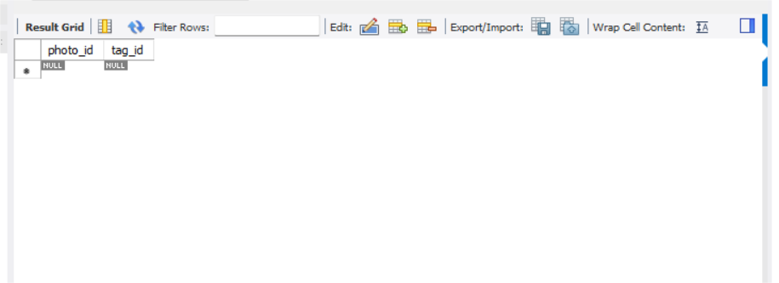
HASHTAG USAGE ANALYSIS
No data was found in the photo_tags table.
The absence of tag data indicates that users are not utilizing hashtags or tagging features.

Slide 18
RECOMMENDATIONS
USER RETENTION
USER ACQUISITION
USER ENGAGEMENT
Personalized content and recommendations.
Feedback from inactive users to reduce churn.
Time- based offers to re-engage users.
Improve onboarding experience
Educate users on tags/ features
Referral program for new users
Reward active users
Build community by organinzing events
Collaborate with influencers

Slide 19
CONCLUSION
Social media platforms like Instagram generate large amounts of user data.
This project uses SQL to analyze user activity, engagement and content performance.
The goal is to derive insights that can help improve marketing strategies and enhance user experience.

Slide 20
THANK YOU!

